Slide 1
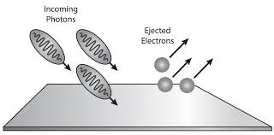
DR. AYAN MUKHERJEE ASSISTANT PROFESSOR Department of physics RAM RATAN SINGH COLLEGE, MOKAMA, PATLIPUTRA UNIVERSITY, PATNA
PHOTOELECTRIC EFFECT
E content for Student of B. Sc Physics Honours
Part II
RAM RATAN SINGH COLLEGE, MOKAMA, PATLIPUTRA UNIVERSITY, PATNA

Slide 2
Our learning goals in this chapter:
To consider the fundamental constituent of light, the photon.
To study the ejection of an electron by an incident photon, the photoelectric effect.
Classical prediction of photoelectric effect.
To understand the concept of Photoelectric Effect
.
Can photoelectric emission possible for incident photon with lower energy than work function.

Slide 3
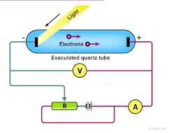
Introduction: What is the photoelectric effect?
When light incident on surface of a metal, electrons can be ejected. The phenomenon is known as the photoelectric effect.
This process is also often referred to as photoemission, and the electrons that are ejected from the metal are called photoelectrons. Electrons in a metal are bound by an energy F, called the work function.
The light gives the electrons enough energy (> Ф) to escape.
Ф is the minimum energy needed to liberate an electron from the metal.
F is defined to be positive.
Measure the flow of electrons with an ammeter.

Slide 4
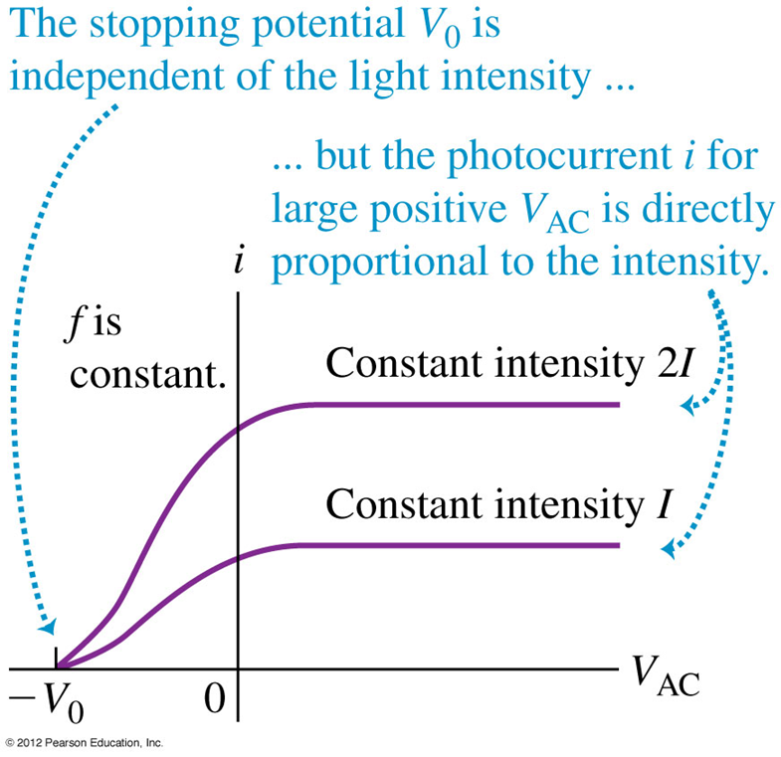
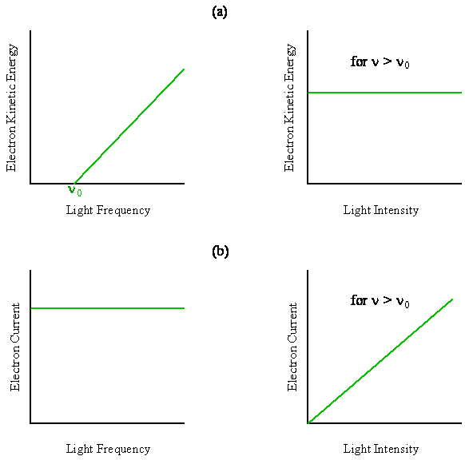
Result of the experiment
Summary of Results:
• Electron energy depends on frequency, not intensity.
• Electrons are not ejected for frequencies below f0.
• Electrons have a probability to be emitted immediately.

Slide 5
Classical wave theory cannot explain the first 3 observations of photoelectric effect.
1. Existence of the threshold frequency
Since energy of the wave is dependent on the square of its amplitude, the classical wave theory predicts that if sufficiently intense light is used, the electrons would absorb enough energy to escape. There should not be any threshold frequency.
2. Almost immediate emission of photoelectrons
Based on classical wave theory, electrons require a period of time before sufficient energy is absorbed for it to escape from the metal. Accordingly, a dim light after some delay would transfer sufficient energy to the electrons for ejection, whereas a very bright light would eject electrons after a short while. However, this did not happen in photoelectric effect.
3. The independence of kinetic energy of photoelectron on intensity and the dependence on frequency
According to classical wave theory, if light of higher intensity is used, the kinetic energy of an ejected electron can be increased. This is because the greater the intensity, the larger the energy of the light wave striking the metal surface, so electrons are ejected with greater kinetic energy. However, it cannot explain why maximum kinetic energy is dependent on the frequency and independent of intensity.

Slide 6
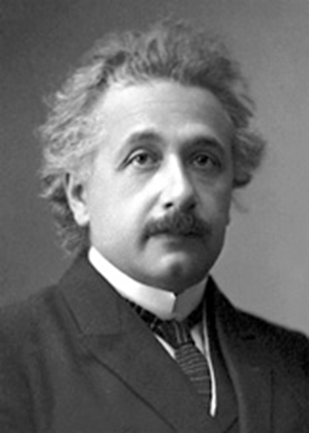
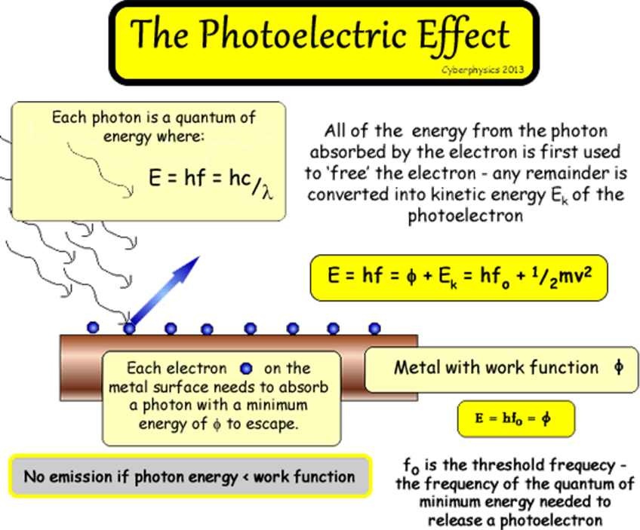
Einstein’s Explanation of Photoelectric Effect
Einstein resolved this problem using Planck’s revolutionary idea that light was a particle. The energy carried by each particle of light (called quanta or photon) is dependent on the light’s frequency (f) as shown:

Slide 7
Summary of photoelectric emission
For a given metal and frequency of incident radiation, the number of photoelectrons ejected per second is directly proportional to the intensity of the incident light.
For a given metal, there exists a certain minimum frequency of incident radiation below which no emission of photoelectrons takes place. This frequency is called the threshold frequency.
Above the threshold frequency, the maximum kinetic energy of the emitted photoelectron is independent of the intensity of the incident light but depends only upon the frequency (or wavelength) of the incident light.
The time lag between the incidence of radiation and the emission of a photoelectron is very small, less then 10-9 second.
This is evidence of the particular nature of light.

Slide 8
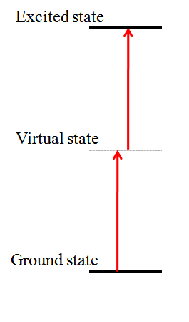
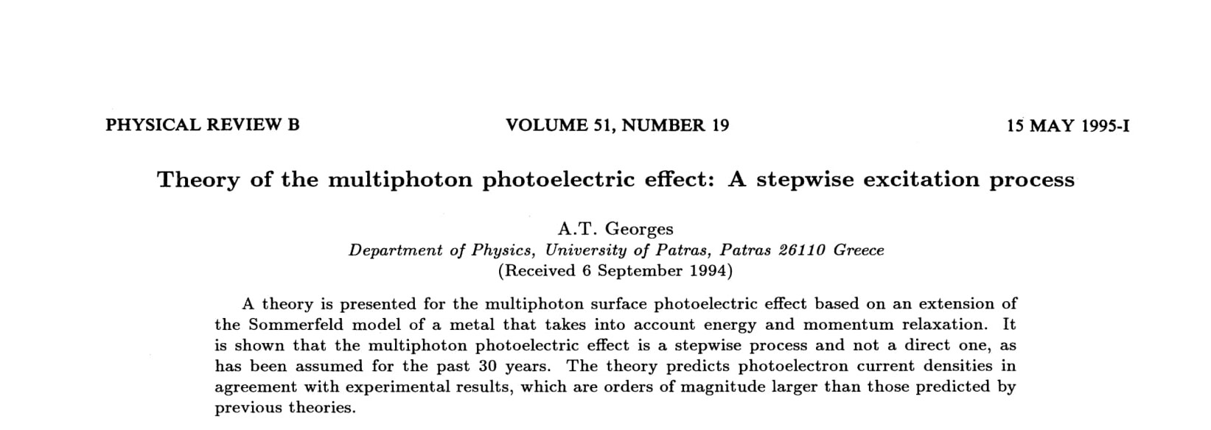
Can light falling with frequency less than threshold frequency emit electron?
In a multiphoton photoelectric process, an electron needs to absorb a given number of photons to escape the surface of a metal. ... A basic hypothesis of the photoelectric process is that the photoemissive properties of matter remain unaltered during the interaction with light.

